Slide 1


Christine Manfield and Arabella Douglas
BENNELONG POINT - OPERA HOUSE 2023

Slide 2
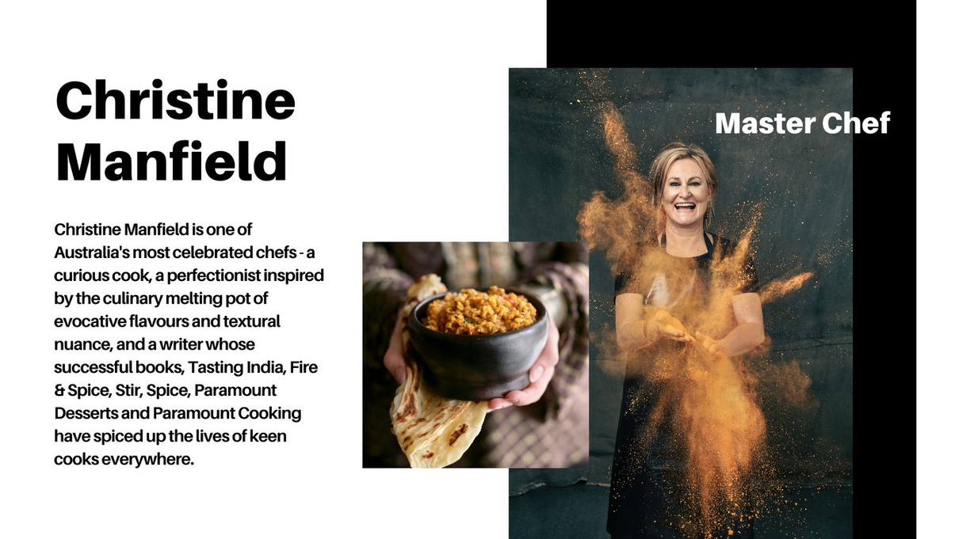

Slide 3

ARABELLA DOUGLAS
Arabella is a Minyungbul Bundjalung woman. Arabella leads Currie Country Group, a Traditional Owner organisation
with grace and grit, imagination, and intellect.
Food is a powerful force for social, economic and environment change. Arabella is a food activist,
supported by her professional skills as a lawyer, economist, and PhD scholar, and grounded in her
cultural practices.
Arabella is committed to reshaping her nation and applying First Nation sciences in leading an
alternate response to the climate crisis using Indigenous sciences.
Arabella's recent contribution to the climate crisis was Bundjalung Nation Flood Report 2022 and advocating at the United Nations 2023
Arabella champions the importance of native ingredients within the framework of Aboriginal
philosophy and the inherent value of food’s connection to the land on which it’s grown.
Currie Country – A First Nation cousin consortium based on her traditional lands of the Tweed Coast.
www.curriecountry.com

Slide 4
LORE/LAW

Slide 5
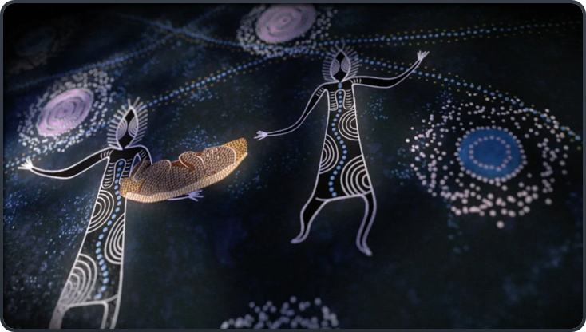
'what is in the stars in mirrored on the landscape of the earth'
STAR LORES - PHYSICS

Slide 6
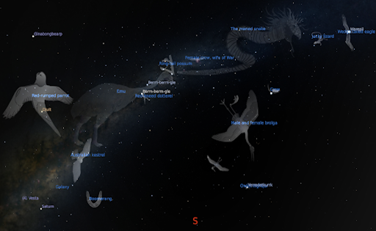
BIRD/STAR LORE

Slide 7
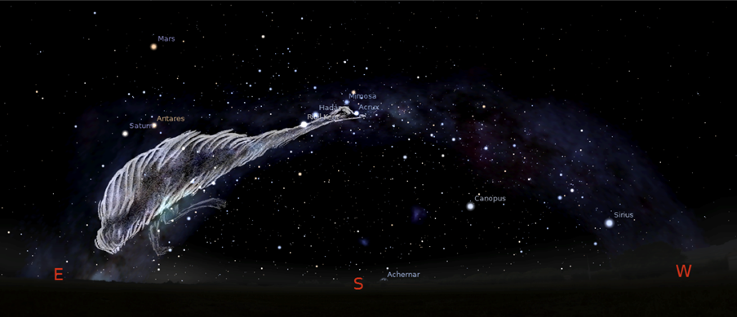
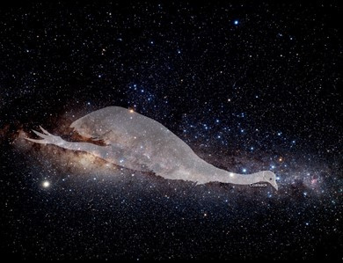
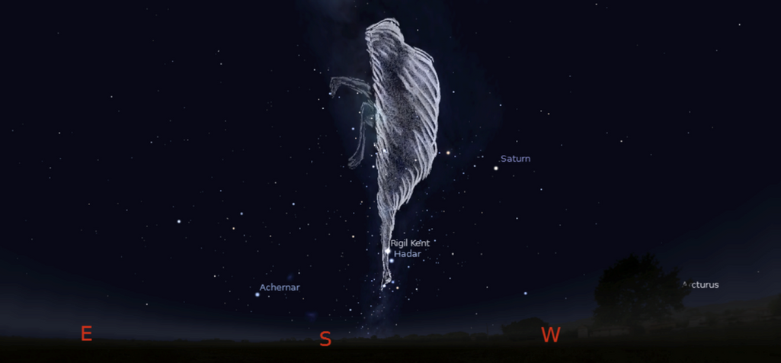
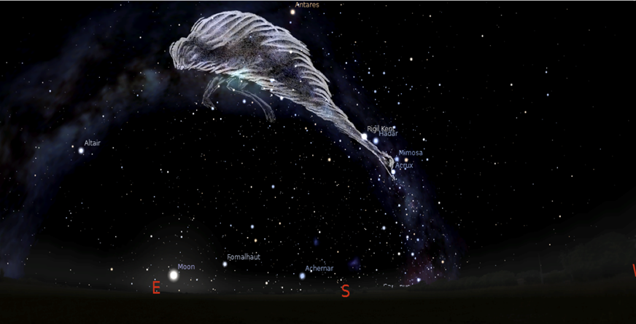
Dark Emu -Muran
Notes:
The milyway is known as the dark emu or the sometimes referred to as bird lore, this is a consistent external celestial clock that First Nations move by, effectively taking their cultural ceremonial and nature clues from the stars. These patterns moves winds, rains, living environments and when a child is raised knowing they are connected to these systems, then understanding how pollution affects weather is not such a large leap, because you are informed that stars and planets are connected to the movement on earth. In the non indigenous environment only scientist or physicists are concerned with how all of these life systems interact, with us as humans beings, seeking to understanding energy, patterns and life systems intimately. This thinking is the core of Aboriginal belief, 'the dreaming' is a system of explaining these sciences systems and localising them so you as an individual person, understand your place within these systems of life, this is expressed through totemic systems, and animals systems to strengthen the connection with all living things.
References
https://academic.oup.com/astrogeo/article/47/5/5.27/231805?login=false
https://www.jstor.org/stable/27000043

Slide 8
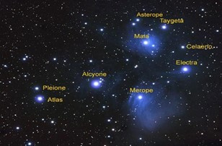
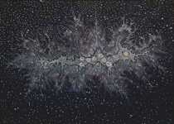
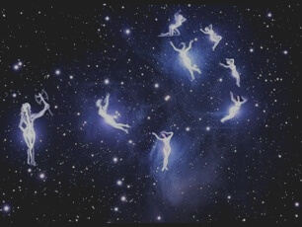
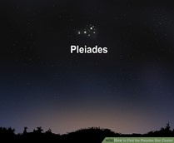
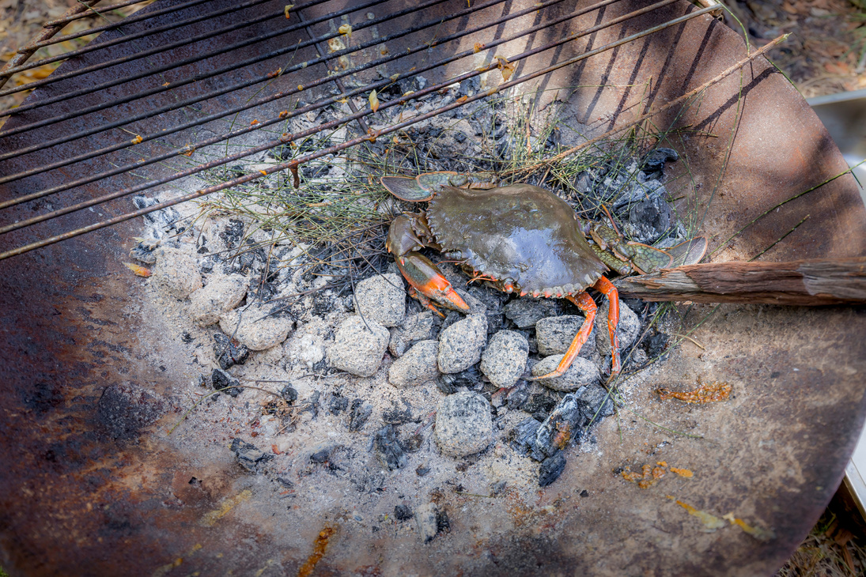
Notes:
One of the cross continental stories East to West Australia is that of the seven sisters 'pleiades' which we call Jiran - this star constellation best seen by the naked eye in our winter months is a story that is similar to the Pleiades Greek story in that it involves sisters who were pursued by men, and escape to the stars. What is interesting is the parallel to Greek Mythos and others cultures.
You will see in the Aboriginal art top right the story of seven sisters reflected in art, and image of star constellation are also on cave art and stone art just outside Sydney.
On our Minyungbal country we celebrate this season and as it falls just to beginning of our initiation period and we share Jiran with women on special women only events we host on country.
References
https://search.informit.org/doi/abs/10.3316/ielapa.626228289052306
https://www.tandfonline.com/doi/abs/10.1080/08145857.2020.1945250
http://www.aboriginalastronomy.com.au/wp-content/uploads/2020/02/Chapter-214-Australian-Aboriginal-Astronomy-and-Cosmology.pdf

Slide 9
ANCIENT

Slide 10
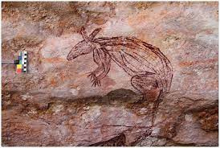
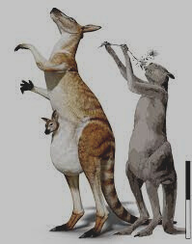
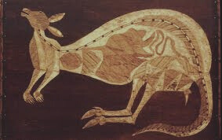
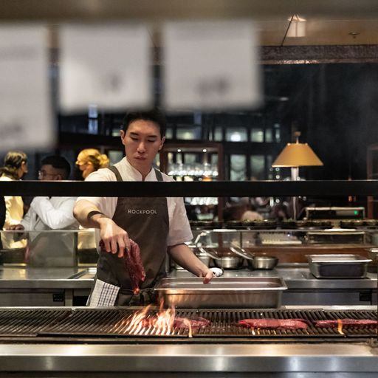
EVOLUTION ART TO PLATE
ART
ROCK ART
Art as a science teaching tool.
Maliwawa Art West Arnhem land -oldest rock art in the world
MEGAFAUNA
Megafaun existed 40,000 years ago.
photo credit Melanie Desa
Notes:
Maliwawa Rock Art Paintings https://www.theguardian.com/artanddesign/2020/oct/01/arnhem-lands-maliwawa-rock-art-a-remarkable-glimpse-into-indigenous-life-10000-years-ago
Climate Change Recorded In Aborginal Art
https://www.archaeology.org/issues/426-2105/letter-from/9623-australia-maliwawa-rock-art
X-Ray Aboriginal Art ( image three on right) is a style of art used as and education tool, to explain and represent the innards of animals as type of medical process, to inform, how to cut meat, and identify organs, and particularities of an animal. This led to Aboriginal clans having a very detailed 'medical level' anatomical specificity in language. The x-ray art aided this form o communication. Aboriginal peoples also has a system of post mortem inquiry, a coronial court which involved watching a body decay to determine cause of death. This practice and intimate understanding of body function, animal anatomy was a key part of what is known as 'lore' systems of inquiry, justice and science. (for more information Aboriginal Australian - Richard Broome 1994 Allen Urwin)

Slide 11
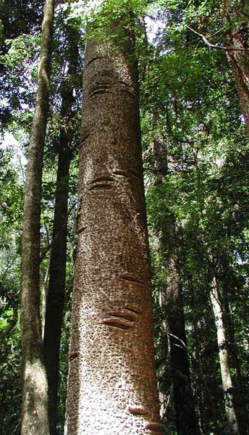
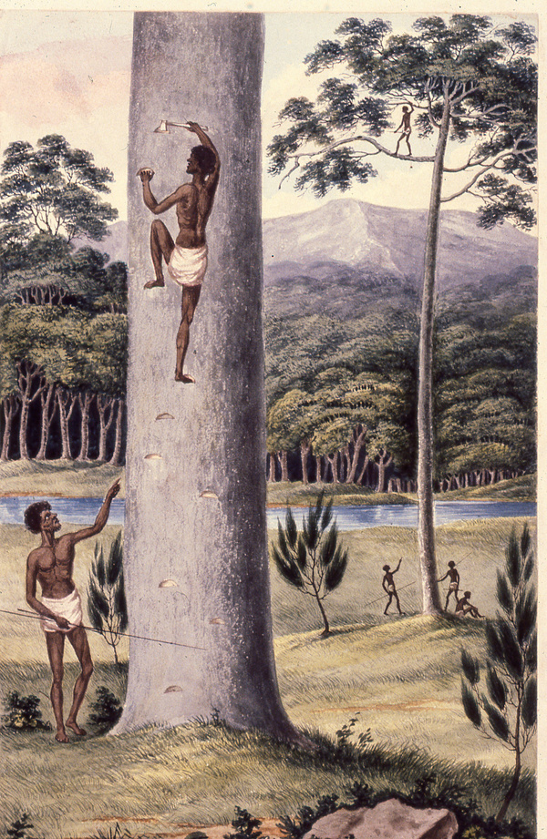
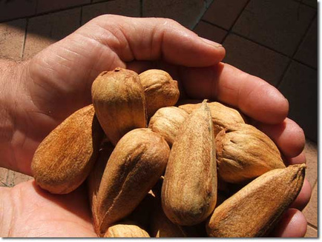
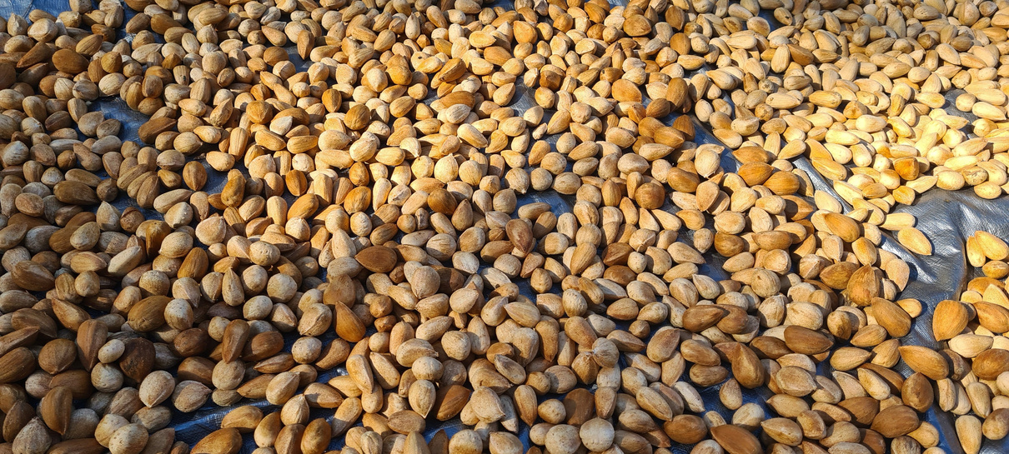
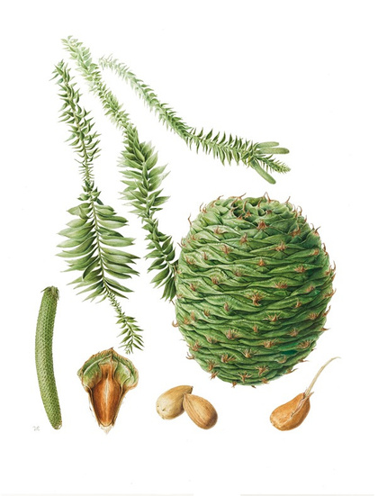
BUNYA BUNYA
Notes:
The watercolour is an image of men in 1820 climbing a tree using a technique that is observed on the Bunya Bunya Tree in Bunya National Park QLD.
References about Bunya festivals, pathways and Trades lines below- this is magnificent tree, and food source which need further attention by creative chefs.
https://www.tandfonline.com/doi/abs/10.1080/03122417.2013.11681966
https://www.foresthistory.org.au/wp-content/uploads/2022/01/anzfh2entire.pdf#page=23
https://www.cambridge.org/core/journals/queensland-review/article/abs/chronology-of-the-bunya-pine/99B28419E719E3DD8E4A78087683FA84

Slide 12
LANGUAGE + NATIONS

Slide 13
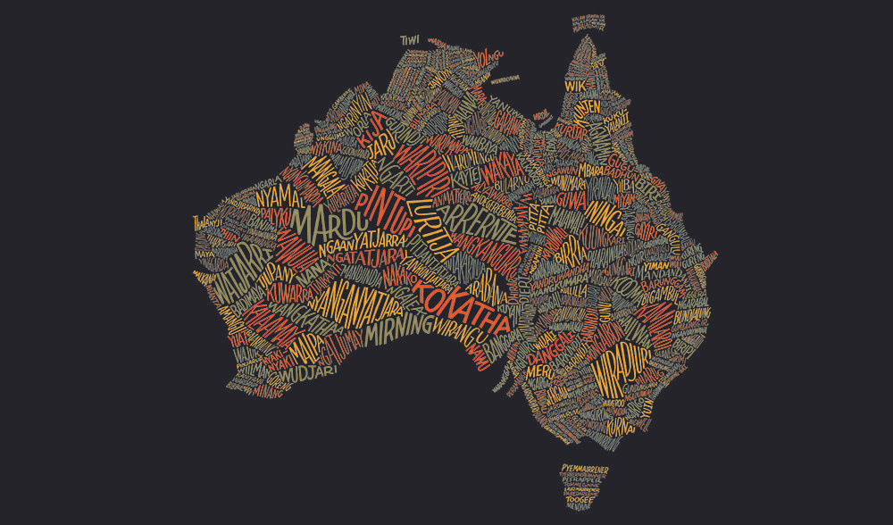
Aboriginal Languages Map

Slide 14
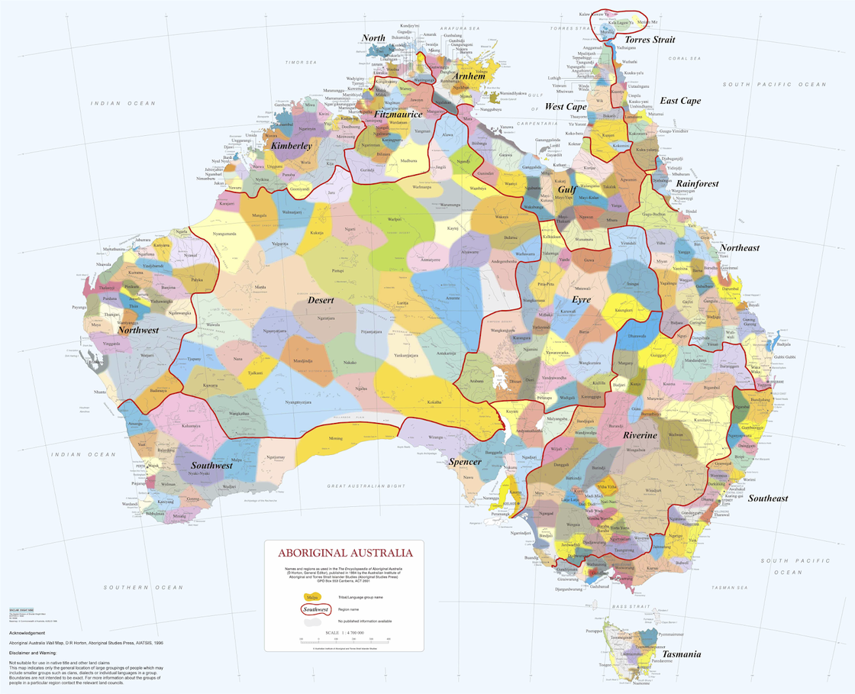

Slide 15



Warndu
warndu.com
Red Centre Enterprises
red-centre.com.au
Indigiearth
indigiearth.com.au
Naway Yila Buradja
Something Wild
somethingwild.com.au
Moojepin Foods
moojepinfoods.com
Special thanks to our First Nations Providors

Slide 16
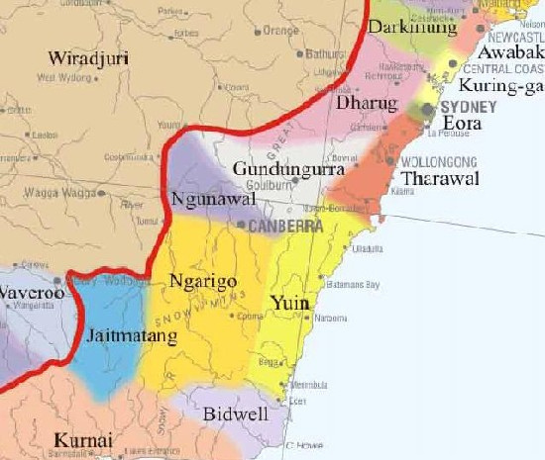

Eora Nation - Sydney NSW
Strawberry gum leaves
Warrigal greens
Native river mint
Karkalla
Sea parsley
Cinnamon myrtle
Lemon myrtle
Illawarra plums
Wiradjuri, Mudgee
Old man’ saltbush
Warrigal greens
Lilly pillies
Lemon aspen
Native river mint
Karkalla

Slide 17
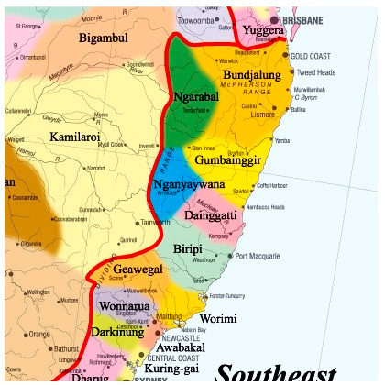

Bundjalung – Northern rivers, NSW
Karkalla
Davidson plum
Finger limes
Native raspberries
Native tamarind
Anise myrtle
Lemon myrtle
Cinnamon myrtle
Barilla saltbush
Marsh saltbush
Sea purslane
Illawarra plums – daalgal, goongum or pine plum
Lilly pilly
Rosella flowers
Sea parsley
Nganyaywana, Northern tablelands NSW
Strawberry gum

Slide 18

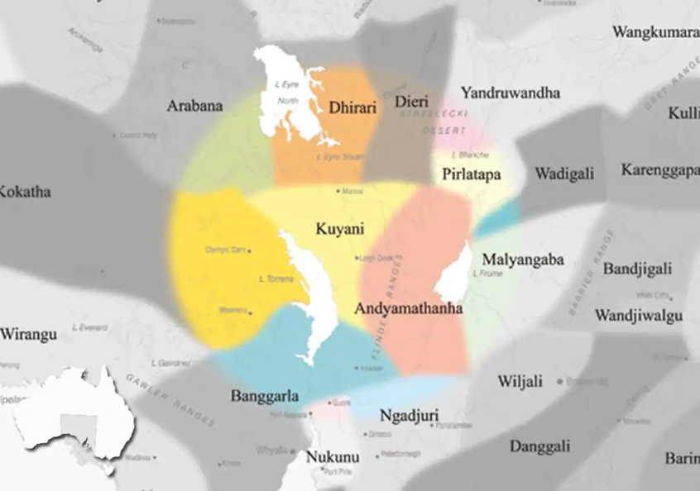
Adnyamathanha – Ikara Flinders Ranges, SA
Quandong – urti – native peach
Native lemongrass
Wattleseed (acacia)
Ngadjuri – Clare Valley, SA
Muntries (native apple)
Lilly pilly

Slide 19
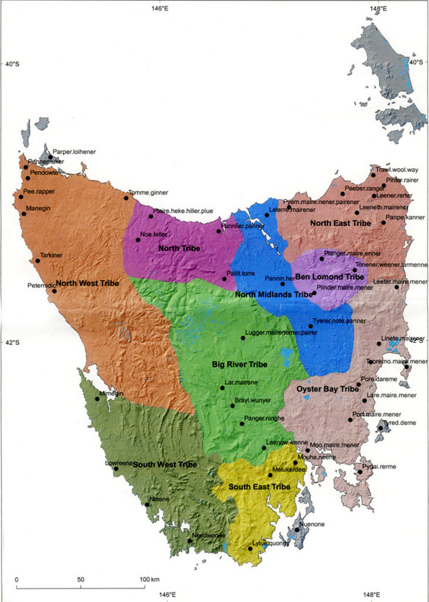
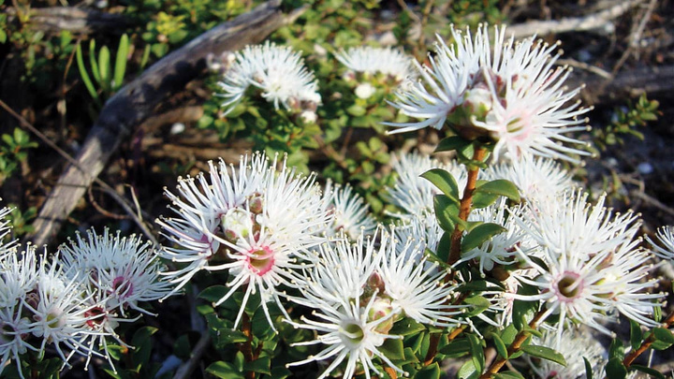
Lutruwita, Tasmania
Native pepper berries
Pepper berry leaves
Sea parsley
White kunzea flowers

Slide 20
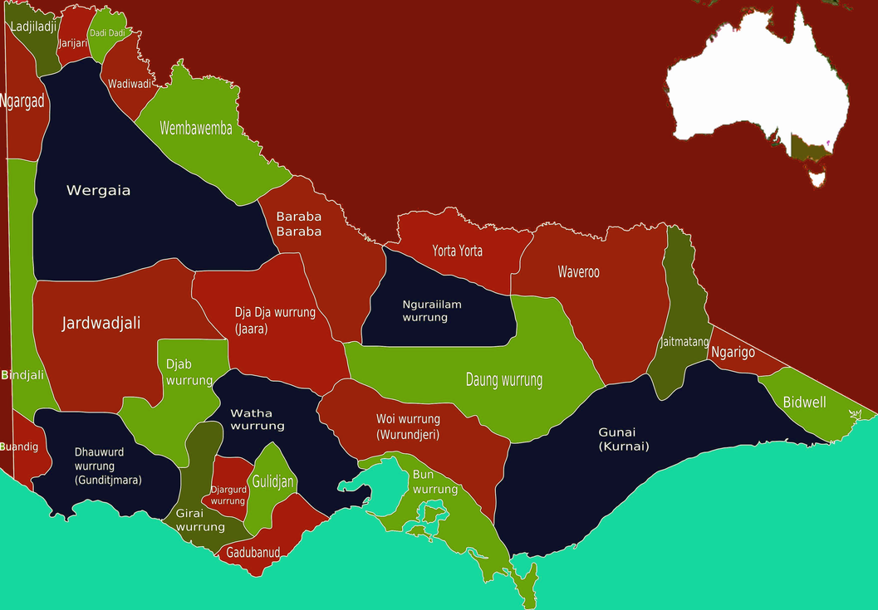
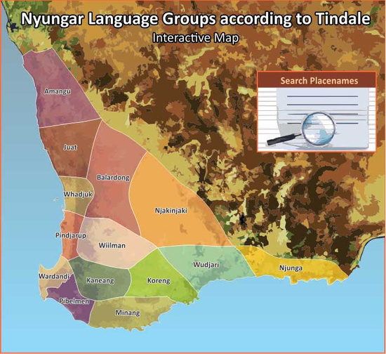
Wurundjeri, VIC
Peppermint gum
Kakadu plum – Gubinge
Noongar/Nyungar, WA
Native blood plums
Native desert limes
Geraldton wax
Sandalwood nuts
Sea parsley

Slide 21
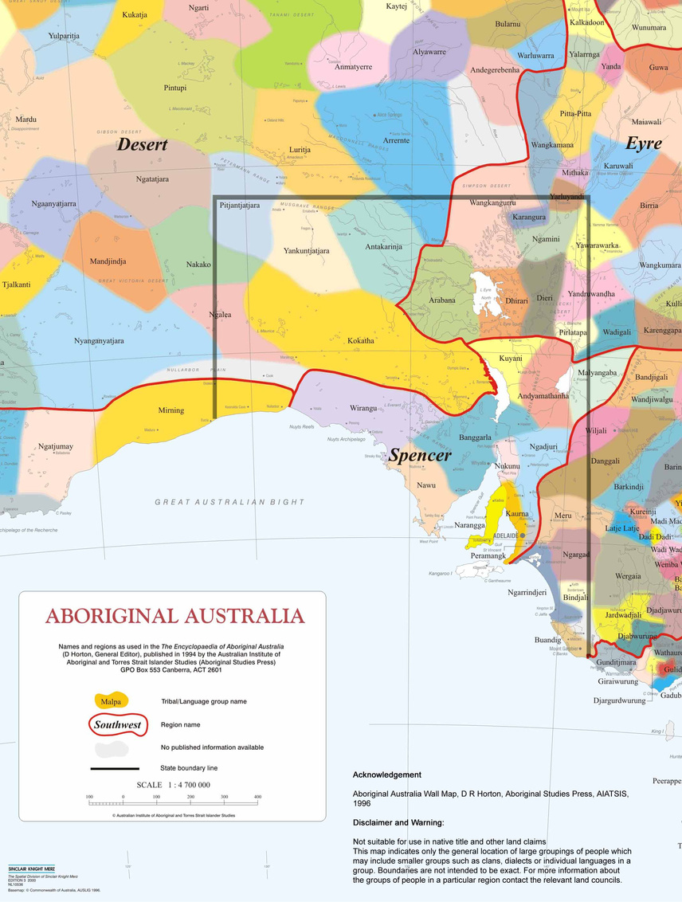
Kaurna, Adelaide, SA
Muntries (native apple)
Coastal wattleseed
native rosemary
native basil
native lemongrass
pepper
native celery
native parsley
river mint
native peppermint
Ngarrindjeri, Coorong, SA
Sandalwood nuts
Ice plant
Samphire
Sea blite

Slide 22
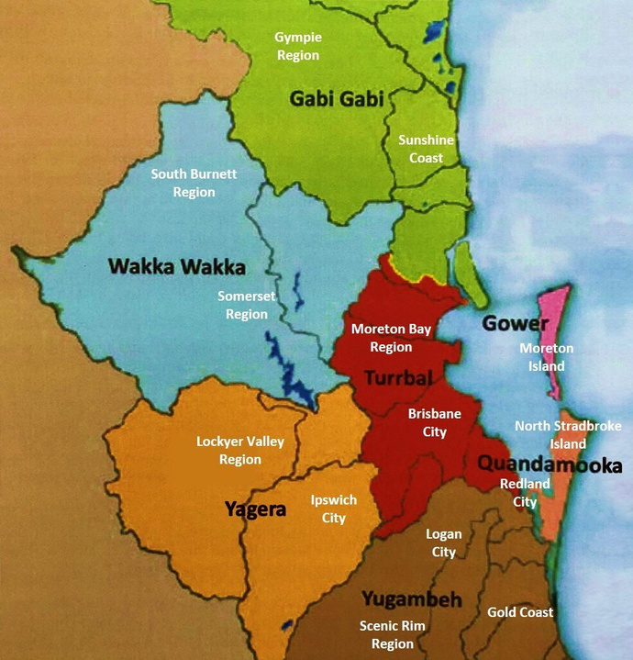
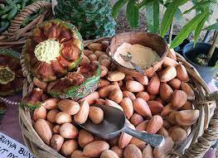
Queensland
Turrbal, Brisbane
Bunya nuts
Gurrumbibarra, Qld
Native tamarind

Slide 23
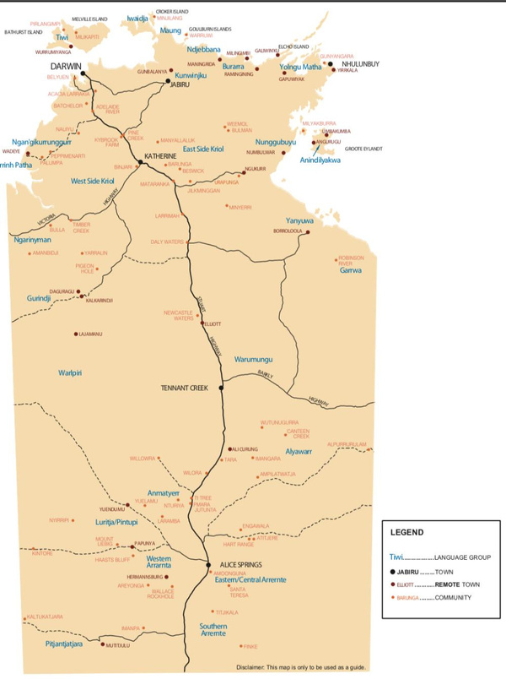
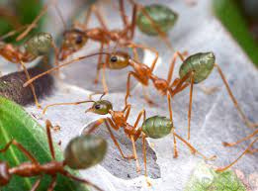
Arrernte, Central Australia, NT
Desert limes
Bush tomato – kutjera or desert raisin
Green ants
blood limes
Mparntwe, NT
Wattleseed (acacia)
Gurrumbibarra, NT

Slide 24


